Slide 1
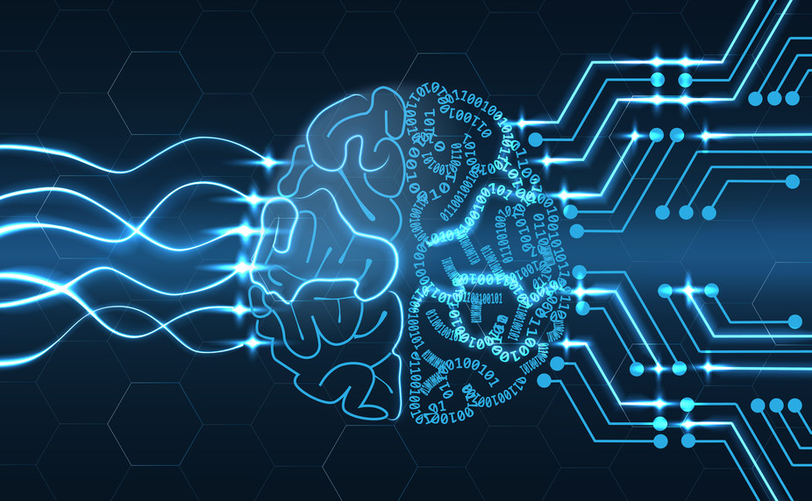
Artificial Intelligence AND MACHINE LEARNING
Tahmid Hossain
CS 131
Notes:
Slide 1: Introduction to Artificial Intelligence and Machine Learning
"Let’s start by defining what we mean by Artificial Intelligence and Machine Learning. Artificial Intelligence, or AI, refers to the ability of machines to perform tasks that typically require human intelligence. These include problem-solving, decision-making, and even learning over time.
Machine Learning, or ML, is a specific subset of AI. It involves the use of algorithms that allow computers to learn patterns from data without being explicitly programmed. Think of it as teaching a computer how to recognize and respond to patterns, much like how we humans learn.
Now, why are AI and ML so important? They power many tools we use every day, like virtual assistants, Netflix recommendations, and even self-driving cars. These technologies are shaping industries and revolutionizing how we live and work."

Slide 2
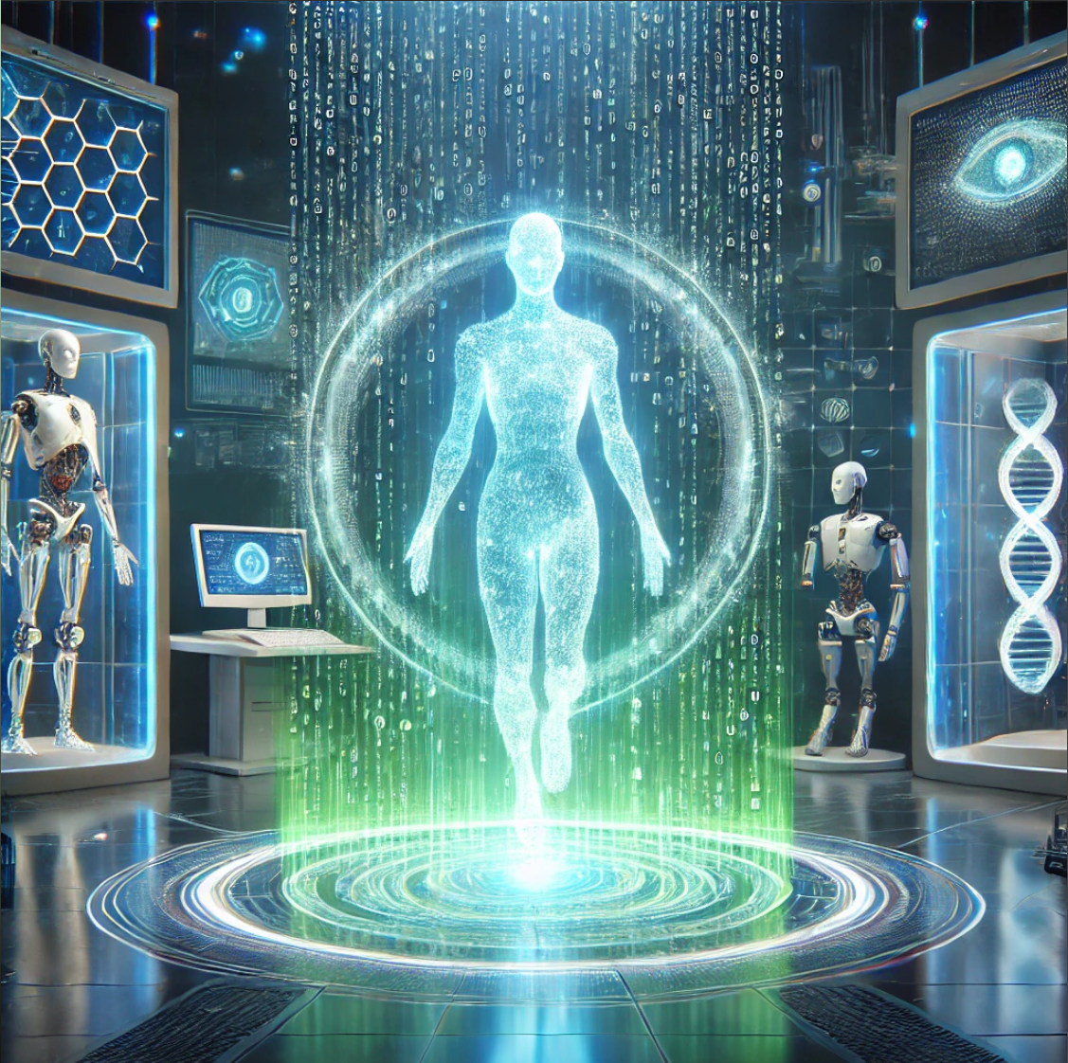
What is A.I.?
AI (Artificial Intelligence) refers to the simulation of human intelligence by machines. It encompasses processes like learning, reasoning, and self-correction. AI systems can perform tasks such as visual perception, speech recognition, decision-making, and language translation, which typically require human intelligence.
Notes:
"Let’s start by defining what we mean by Artificial Intelligence and Machine Learning. Artificial Intelligence, or AI, refers to the ability of machines to perform tasks that typically require human intelligence. These include problem-solving, decision-making, and even learning over time.

Slide 3
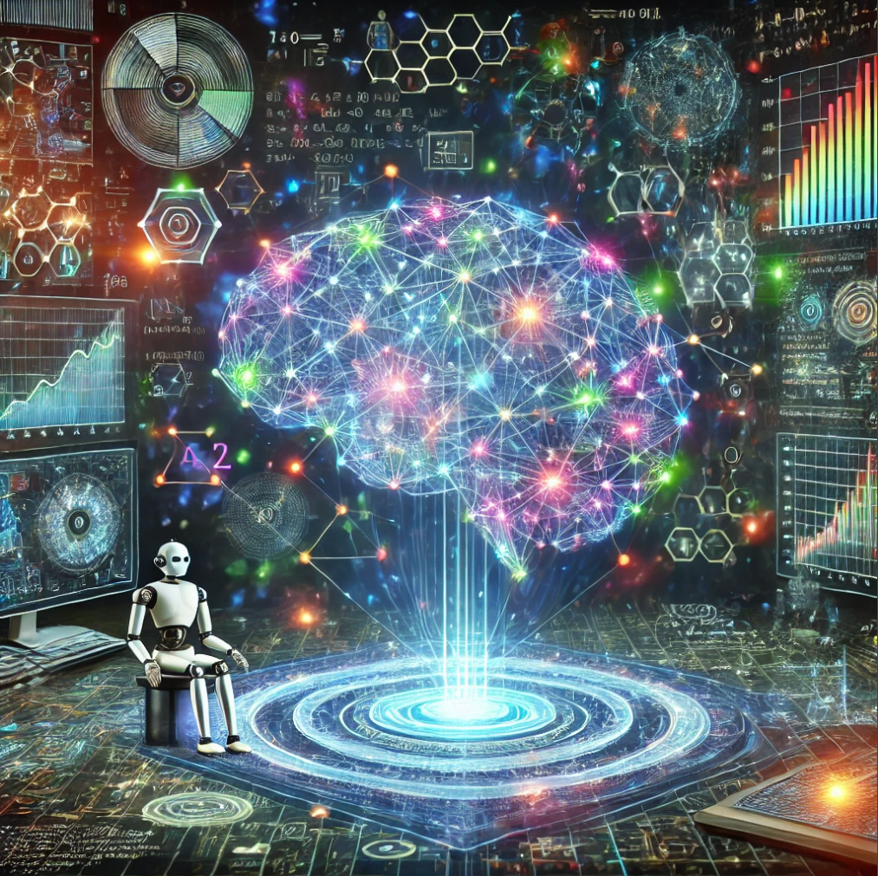
What is M.L.?
ML is a subset of AI that focuses on developing algorithms that allow machines to learn patterns from data and make predictions or decisions without explicit programming. It involves training a model using data and enabling it to improve its performance over time.
Notes:
Machine Learning, or ML, is a specific subset of AI. It involves the use of algorithms that allow computers to learn patterns from data without being explicitly programmed. Think of it as teaching a computer how to recognize and respond to patterns, much like how we humans learn.

Slide 4
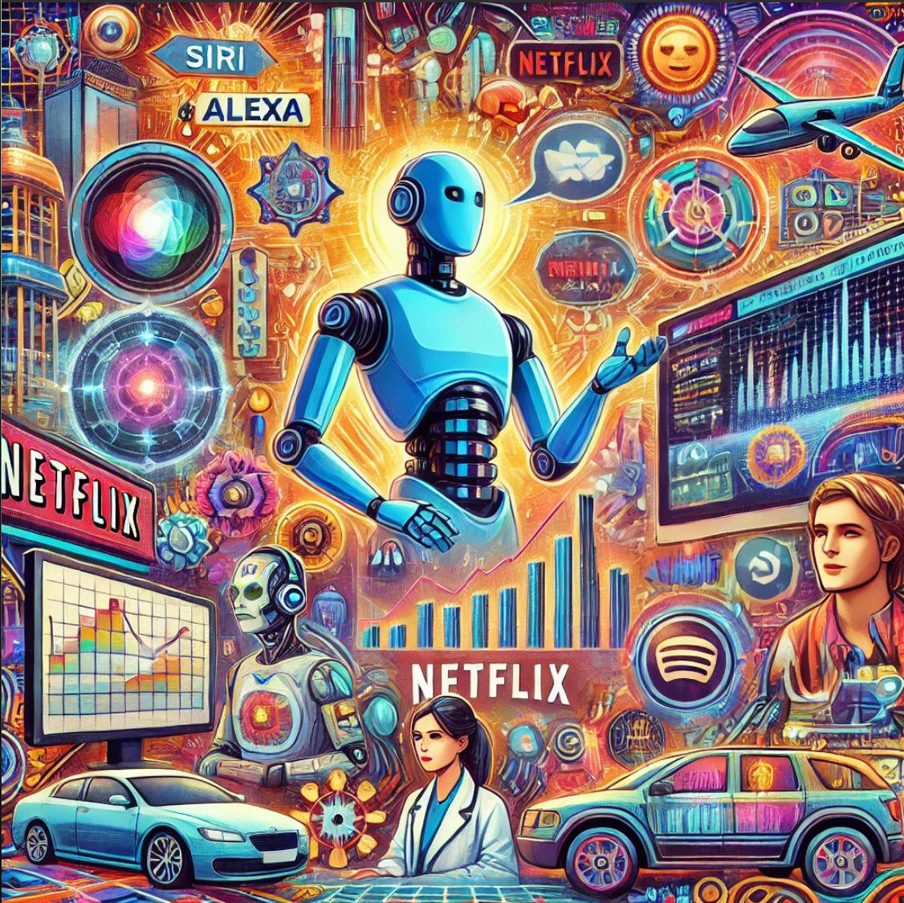
Why A.I. and M.L. Matter
AI and ML power technologies like Siri, Alexa, Google Translate, and Netflix recommendations.
Industries like healthcare, finance, and transportation are leveraging AI for better efficiency and accuracy.
AI contributes to advances in robotics, automation, and data analysis, transforming society.
Notes:
Now, why are AI and ML so important? They power many tools we use every day, like virtual assistants, Netflix recommendations, and even self-driving cars. These technologies are shaping industries and revolutionizing how we live and work.

Slide 5

Historical Milestones in AI Development
1950s
1956 – Dartmouth Conference
1960s-70s
Alan Turing proposed the concept of a "universal machine," capable of solving any problem that could be described algorithmically.
The Turing Test was introduced to evaluate a machine's ability to exhibit human-like intelligence.
The term "Artificial Intelligence" was coined.
Researchers like John McCarthy, Marvin Minsky, and others gathered to explore machine learning and reasoning.
Development of programs like ELIZA, an early chatbot simulating human conversation.
SHRDLU, a natural language processing system, demonstrated limited AI in manipulating virtual blocks.
1980s
2000s - present
Neural networks and the backpropagation algorithm were introduced, enabling machines to adjust learning based on feedback.
Expert systems were created to emulate human expertise in specific domains.
Advancements in computational power and access to big data led to breakthroughs in deep learning and natural language processing.
Technologies like Google’s DeepMind and OpenAI emerged, showcasing AI’s potential in gaming, language generation, and real-world problem-solving.
Notes:
"AI has an interesting history. Let’s go back to the 1950s. Alan Turing, a pioneer in computer science, proposed a concept called the 'universal machine,' which could simulate any human thought process. He also introduced the Turing Test, a way to evaluate a machine's ability to exhibit intelligent behavior.
In 1956, the Dartmouth Conference officially marked the beginning of AI as a field of study. This was when researchers began to explore how to create machines that could 'think.'
By the 1960s and 1970s, we saw the development of programs like ELIZA, an early chatbot, and SHRDLU, which could interact with users in a simple virtual environment. The 1980s brought neural networks and backpropagation, laying the groundwork for today’s AI. Then, in the 2000s, the explosion of data and advances in computing power led to the rise of deep learning, enabling the AI boom we see today."

Slide 6
Evolution of Machine Learning
Early Beginnings:
In the 1950s, Arthur Samuel developed one of the first machine learning systems: a checkers-playing program that improved with experience.
Supervised Learning
Reinforcement Learning
Unsupervised Learning
Uses labeled data to teach the system. Example: Email spam filters learn to identify spam by analyzing pre-labeled spam and non-spam emails.
Identifies patterns in unlabeled data.
Example: Clustering algorithms group customers based on purchasing behaviors.
The system learns by interacting with the environment, receiving rewards for correct actions.
Example: AlphaGo, which mastered the game of Go through trial and error.
Modern ML Advancements:
Increased computational power allows for larger models with more parameters.
Access to vast datasets has enabled highly accurate predictions in fields like medicine, finance, and entertainment.
Notes:
"Machine Learning has evolved significantly over the years. In the early days, Arthur Samuel created a program that could play checkers better over time by learning from experience—this was one of the first demonstrations of machine learning in action.
Today, ML operates in three main paradigms. First, there’s supervised learning, where we train models using labeled data—for example, teaching a model to recognize cats in photos by showing it labeled examples.
Second is unsupervised learning, which looks for patterns in unlabeled data. A good example is clustering, where data points are grouped based on similarity.
Finally, there’s reinforcement learning, where models learn through trial and error, like how robots learn to walk or how AlphaGo mastered the game of Go.
Advances in computing and the availability of massive datasets have made these learning methods highly effective in solving real-world problems."

Slide 7
KEY COMPONENTS OF A.I. and M.L.
1. Data Collection and Preprocessing
2. Algorithm Selection
Quality and quantity of data are crucial. Data must be cleaned to remove errors or inconsistencies.
Decision trees for interpretability.
Neural networks for complex pattern recognition.
Support Vector Machines for classification problems.
3. Model Training
Data is split into training and testing datasets.
The model learns patterns in the training data and generalizes to new data.
4. Evaluation Metrics
Accuracy measures how often the model is correct.
Precision and recall assess performance on specific classes, such as fraud detection.
F1 score balances precision and recall.
5. Deployment and Monitoring
Deployed models need continuous monitoring to ensure accuracy over time as data evolves.
Notes:
Slide 7: Key Components of AI and ML
"Developing AI and ML systems involves several critical steps. First, we start with data collection. For example, if we’re training an AI to detect fraudulent transactions, we gather data on both fraudulent and legitimate transactions.
Next, we preprocess this data to clean and format it for analysis. Then, we choose an algorithm. For fraud detection, we might use decision trees or neural networks depending on the complexity.
We train the model by feeding it data and adjusting parameters to minimize errors. Once trained, we evaluate its performance using metrics like accuracy and precision.
Finally, the model is deployed into a real-world environment, such as a banking system, where it begins to analyze transactions in real time. Monitoring and updating the model is essential to ensure it stays effective as conditions change."

Slide 8




Current Trends in AI and ML
Generative AI
AI in Healthcare
AI in Transportation
Ethical Consideration
GPT-4 and DALL-E can create human-like text and images, opening possibilities in content creation, design, and virtual reality.
Applications: Writing articles, designing logos, and generating lifelike avatars.
AI analyzes medical images for early diagnosis of diseases like cancer.
Personalized treatment plans using patient data.
Self-driving cars use AI for navigation, obstacle detection, and decision-making.
AI optimizes traffic flow and public transit systems.
(Tesla is a great example for this)
Addressing algorithmic bias to prevent discrimination.
Ensuring transparency and accountability in decision-making systems.
Balancing innovation with privacy concerns.
Notes:
Slide 8: Current Trends in AI and ML
"AI is advancing rapidly, with some fascinating trends emerging. Generative AI, like GPT-4, can create human-like text and images. For example, these models can write essays, compose music, or even design artwork.
AI is also making a huge impact across industries. In healthcare, AI helps analyze medical images to detect diseases earlier. In finance, it identifies fraudulent transactions in real time. And in transportation, it powers autonomous vehicles.
However, with these advancements come ethical challenges. How do we ensure AI systems are fair and unbiased? How do we maintain transparency in decision-making? Addressing these questions is critical as AI becomes more integrated into our lives."
Generative AI
Example 1: ChatGPT (e.g., GPT-4):
Use Case: Writing essays, answering customer support queries, or creating programming code.
Example Scenario: A company uses GPT-4 to generate automated responses for FAQs, significantly reducing the workload on human agents.
Example 2: DALL-E:
Use Case: Generating realistic images from textual descriptions.
Example Scenario: A marketing agency creates custom visuals for advertising campaigns using DALL-E, eliminating the need for costly photo shoots.
Example 3: DeepFake Technology:
Use Case: Synthesizing realistic videos for media production.
Example Scenario: A movie studio uses generative AI to digitally recreate a historical figure for a documentary.
AI in Healthcare
Example 1: Radiology and Imaging:
Use Case: AI analyzes X-rays, MRIs, and CT scans to detect diseases like cancer.
Example Scenario: Hospitals use AI models to screen for breast cancer with higher accuracy and speed than human radiologists.
Example 2: Personalized Medicine:
Use Case: Tailoring treatment plans based on a patient’s genetic makeup and health data.
Example Scenario: Oncologists use AI to predict the most effective chemotherapy regimen for individual cancer patients.
Example 3: Drug Discovery:
Use Case: AI accelerates the process of discovering new drugs.
Example Scenario: AI algorithms identify potential compounds for new antibiotics within weeks instead of years.
AI in Transportation
Example 1: Autonomous Vehicles:
Use Case: Self-driving technology uses AI to navigate, detect obstacles, and make decisions.
Example Scenario: Tesla’s Autopilot uses computer vision and machine learning to assist with highway driving and parking.
Example 2: Traffic Optimization:
Use Case: AI predicts and mitigates traffic congestion using real-time data.
Example Scenario: Google Maps uses AI to provide alternate routes based on live traffic updates, reducing travel times.
Example 3: Fleet Management:
Use Case: Logistics companies use AI to optimize delivery routes.
Example Scenario: Amazon leverages AI to predict demand and dynamically allocate delivery resources for same-day shipping.
Ethical Considerations
Example 1: Bias in Hiring Algorithms:
Use Case: AI-powered hiring tools may inadvertently favor certain demographics.
Example Scenario: An AI system used for hiring disproportionately recommends male candidates for leadership roles due to biased training data.
Example 2: Transparency in Healthcare AI:
Use Case: Lack of transparency in decision-making.
Example Scenario: A hospital using AI for diagnosis faces criticism because the system’s recommendations cannot be easily explained to patients.
Example 3: Privacy Concerns:
Use Case: AI systems collecting sensitive data may risk violating privacy.
Example Scenario: Facial recognition systems in public spaces raise concerns about surveillance and consent.

Slide 9

Future Directions and Challenges
Artificial General Intelligence
Explainable AI
AGI aims to develop machines that can perform any intellectual task a human can, but achieving this level of intelligence remains a significant challenge.
As AI becomes more complex, understanding how it reaches decisions is crucial, particularly in high-stakes fields like healthcare and criminal justice.
Societal impact
Regulation and Governance
AI automation may displace jobs but also create new opportunities in AI-related fields.
Governments and organizations must prepare for transitions and reskilling the workforce.
Policies are needed to ensure responsible AI development, focusing on ethics, privacy, and safety.
Notes:
Slide 9: Future Directions and Challenges
"The future of AI holds exciting possibilities. Researchers are working toward Artificial General Intelligence, or AGI, which refers to machines capable of performing any intellectual task a human can. While AGI is still far off, progress in this area could fundamentally change how we interact with machines.
Another challenge is explainability—ensuring we understand how AI systems make decisions. This is crucial in sensitive areas like healthcare and law, where decisions have significant consequences.
Finally, we must consider the societal impacts of AI. Automation could disrupt jobs, but it also creates opportunities for new roles. Governments and organizations need to work together to ensure a smooth transition and equitable distribution of AI’s benefits."

Slide 10

CONCLUSION
KEY TAKEAWAYS: AI and ML have evolved from theoretical ideas to essential tools in modern life.
They present immense opportunities for innovation but require ethical and transparent development to ensure societal benefit.
CALL TO ACTION: Stay informed about the impact of AI and ML
Participate in discussions about their ethical use
Embrace lifelong learning to adapt to an AI-driven world
Notes:
Slide 10: Conclusion
"In summary, AI and ML have come a long way, from early theoretical concepts to powerful tools driving innovation in almost every field. These technologies hold immense potential, but with great power comes great responsibility.
As we develop and deploy AI, we must prioritize ethical considerations to ensure these systems benefit society as a whole. I encourage you to stay informed about AI, engage with its possibilities, and contribute to the conversation about its future."

Slide 11

END

